Slide 1

Lesson Plan
By
Priyanka Rane.

Slide 2
Class- Jr.Kg.
No of Students- 20.
Aim- To Teach Childrens about Numbers.
Topic- Numbers(1 to 5).
Sub- Maths.
Specific Aim- To Teach Childrens how to Write Numbers 1 to 5.
Previous Knowledge- Children will learn about Numbers.

Slide 3
INTRODUCTION
Childrens Today I will teach You Some thing New…
How to Write Numbers in Sequence One by One. By easy method.
Then I teach you there spelling.

Slide 4
Materials
Through Power Point Presentation.(PPT).
Flash Cards.

Slide 5
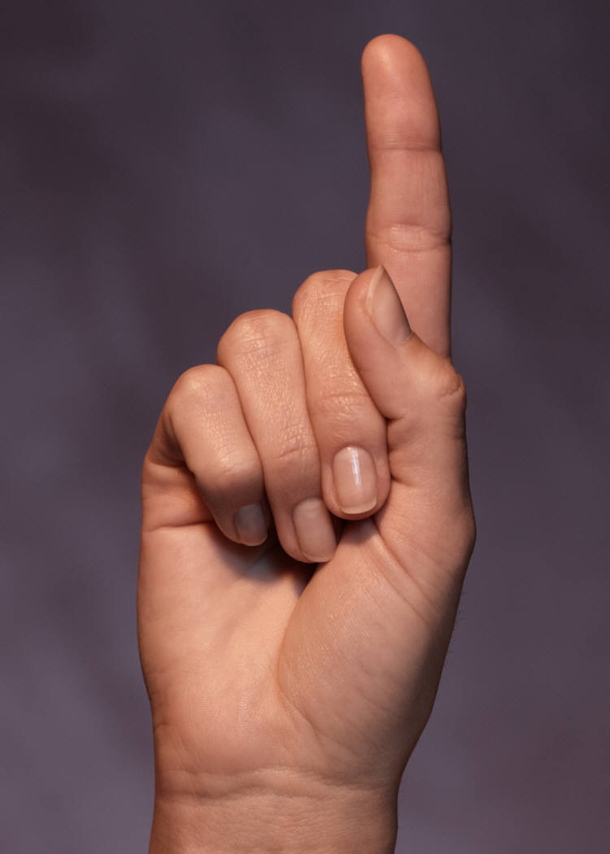
Instruction
For 1 Draw Standing Line.Like this & there spelling is one
ONE

Slide 6
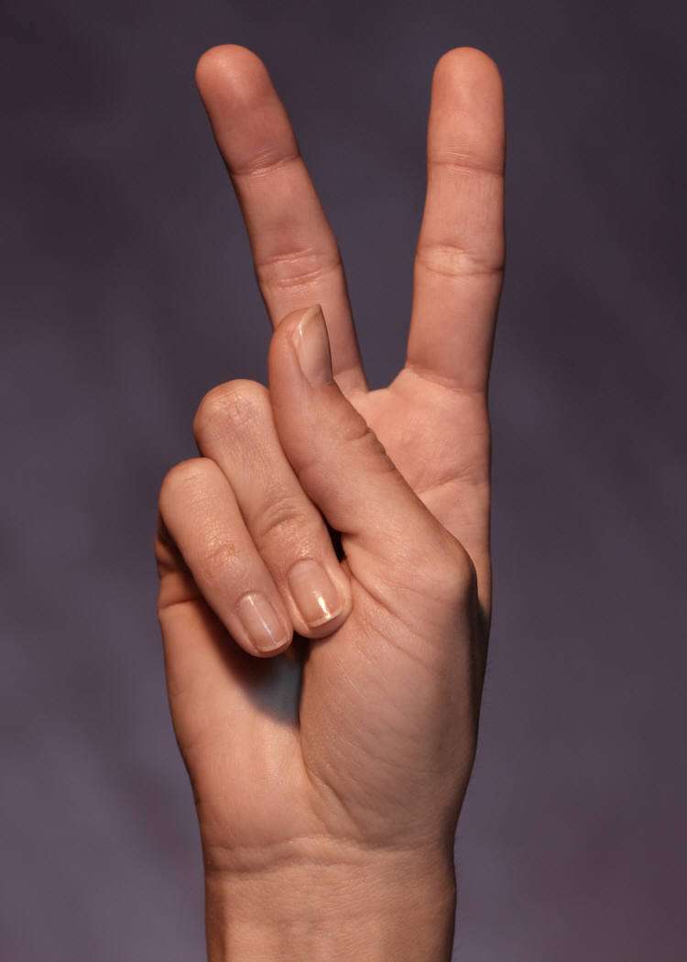
For 2 Draw Curve & then a Sleeping Line, Like this
TWO

Slide 7
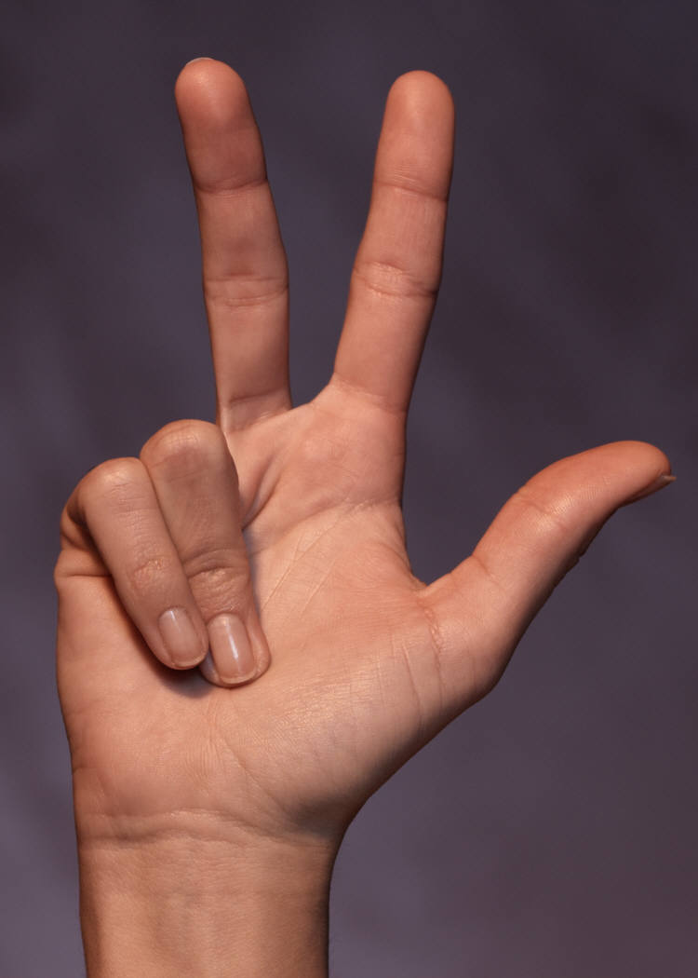
For 3 Draw A Curve & Then
Other Curve
THREE

Slide 8
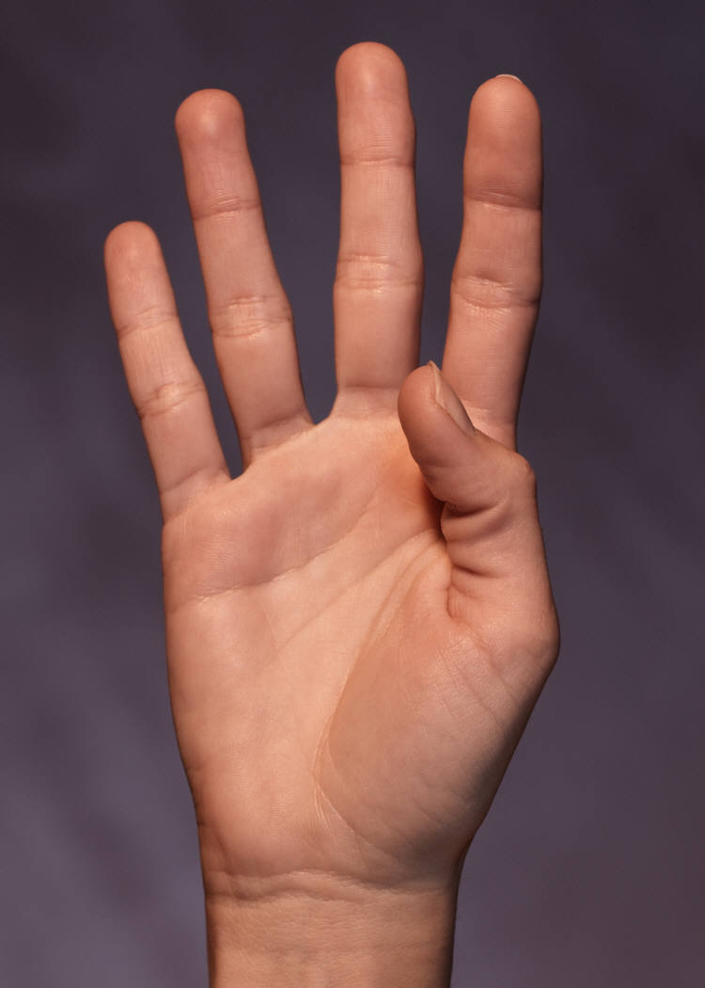
For 4 First Draw Standing Line, Sleeping Line
& then again Standing Line
FOUR

Slide 9
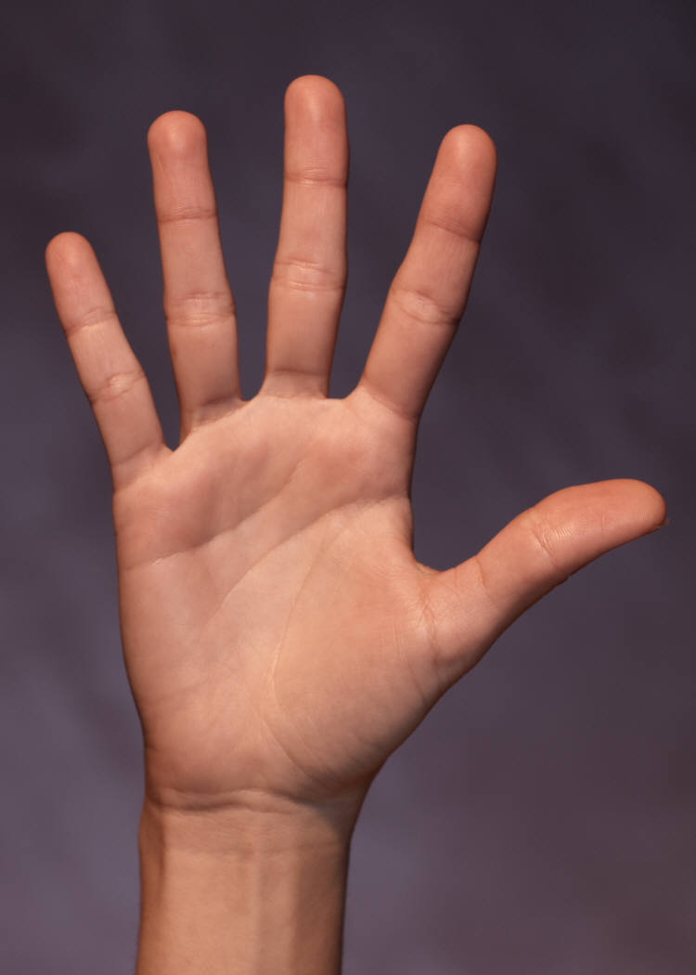
For 5 First Draw Sleeping Line, Then a Small Standing Line & then a Curve.
FIVE

Slide 10
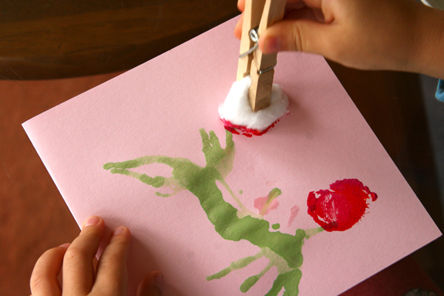
Worksheet No:- 1 (Activity) Cotton Dabbing. Name:-
Aim:- Cotton Dabbing. Date:-02/12/2014
Instruction:- Dip the Cotton in Colour and dabb- Class:- Jr.Kg.
the cotton in side the Number.
----------------------------------------------------------------------------------------------------------

Slide 11
Worksheet No:- 2 Writing Readiness. Name:-
Aim:- Write Number & Spelling. Date:- 02/12/2014.
Instruction:- Write the Spelling below the Number. Class:- Jr.Kg.
-----------------------------------------------------------------------------------------------------------------
5 Five ___ ___ ___ ___ ___
1 One ____ ___ ____ ____ ___
2 Two ____ ____ ____ ____ ____
3 Three ____ ____ ____ ____ ____
4 Four ____ ____ _____ ____ ____

Slide 12


Worksheet No:- 3 Number Readiness. Name:-
Aim:- Write Correct Answer. Date:- 02/12/2014.
Instruction:- Count & Circle the Correct Answer. Class:- Jr.Kg. -----------------------------------------------------------------------------------------------------------------
5
3
2
1
5
4
1
2
2
5
2
4
1
3
5

Slide 13
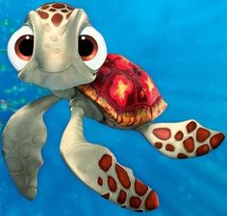
Turtles
One baby turtle alone and new
Finds a friend, and then there are two.
Two baby turtles crawl down to the sea.
They find another, and then there are three.
Three baby turtles crawl along the shore.
They find another, and then there are four.
Four baby turtles go for a dive.
Up swims another, and then there are five.

Slide 14
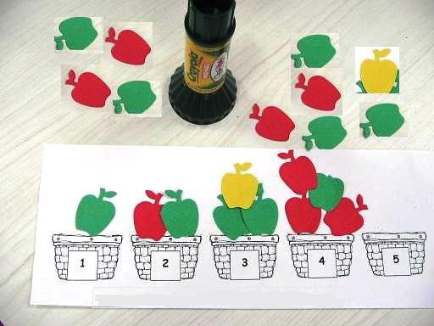
Worksheet No:- 5 (Organised Game). Name:-
Aim:- Stick Apple to Current Basket. Date:- 02/12/2014.
Instruction:- Take the apple cut-out & stick they Class:- Jr.Kg.
to correct no basket. -----------------------------------------------------------------------------------------------------------------

Slide 15

.THANK YOU.

